Slide 1
AI-Powered Collections Strategy
Leveraging Agentic AI for Scalable, Fair, and Effective Debt Management at Geldium

Slide 2
How the System Works
Inputs: What customer data is collected (e.g., demographics, repayment history, credit utilization)?
Decision Logic: How are actions determined? Does the system use business rules, model predictions, or both?
Actions: What outreach or interventions would be triggered (e.g., payment reminders, hardship offers)?
Learning: How will the system track outcomes and improve over time?
Notes:
Prompts to try:
Generate a simple outline for an AI collections system workflow, including inputs, decision logic, action triggers, and learning loop.
List 3–5 key customer attributes that would be most predictive for collections decision-making, and explain why each one matters.
Suggest examples of business rules and AI-driven actions the system could use at different risk levels (e.g., low, medium, high risk).
Create a rough sketch or step-by-step description of how customer data flows through the system from intake to action.

Slide 3
Customer Data Inputs
Customer financial data (Income, Credit Score, Debt-to-Income Ratio)
Credit behavior data (Credit Utilization, Missed Payments)
Payment history (Month 1–Month 6)
Account information (Loan Balance, Account Tenure)

Slide 4
AI Risk Assessment
Predictive model calculates delinquency risk score
Key drivers analyzed:
- Credit utilization
- Missed payments
- Debt-to-income ratio
- Credit score

Slide 5
Automated Decision Logic & Automated Actions
Customers categorized into risk tiers
-Low Risk
-Medium Risk
-High Risk
Low risk → Payment reminders
Medium risk → Personalized repayment plans
High risk → Collections team outreach

Slide 6
Learning Loop
System tracks outcomes of interventions
Updates model using new payment behavior
Improves predictions over time through continuous learning

Slide 7
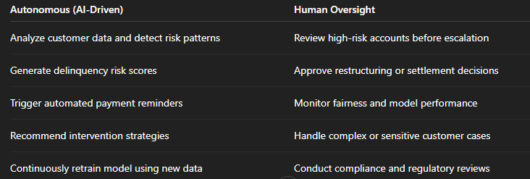
Role of Agentic AI
Notes:
Prompts to try:
Explain how agentic AI could automate financial collections while keeping humans in critical decision points.
List 3–5 examples of collection actions, and classify each as best suited for full automation or requiring human oversight, with a brief reason why.

Slide 8
Responsible AI Guardrails
Fairness Monitoring
Regular audits to ensure the model does not unfairly impact certain customer groups.
Explainability
Provide clear explanations of risk predictions using key factors like missed payments and credit utilization.
Human-in-the-Loop Oversight
Require human review for high-risk decisions or account escalation.
Regulatory Compliance
Ensure alignment with financial regulations, responsible lending practices, and data privacy requirements.
Notes:
Prompts to try:
List key fairness, transparency, and compliance practices to build into an AI-powered credit collections system.
Suggest specific ways to monitor and audit the system over time to ensure it stays fair, compliant, and effective.

Slide 9
Expected Business Impact
Business KPIs
- 10–15% reduction in delinquency rates
- 20% faster identification of high-risk customers
- 15% improvement in collections recovery rates
- Lower operational costs through automation
- Improved model accuracy over time through continuous learning
Customer Outcomes
- Earlier financial support for at-risk customers
- More personalized repayment options
- Reduced financial stress through proactive engagement
- Fair and transparent decision-making
- Improved customer trust and experience
Notes:
Prompts to try:
Suggest KPIs for an AI-powered collections strategy that balances business outcomes with customer fairness.
Describe 2–3 ways an AI collections system could improve both operational efficiency and customer experience.

